Slide 1


Department of Computer Science and Engineering
Blended Ensemble Learning for Demand Prediction: An AutoML Driven Approach
Dr. Senthil Pandi S
Team ID:B21A2425C22
Mohamed Hussain (210701161)
Nathaniel Abishek (210701173)

Slide 2
Problem Statement and Motivation
Manual Model Selection & Tuning:
Selecting and fine-tuning machine learning models manually is time-consuming and requires expertise.
Suboptimal tuning leads to lower prediction accuracy and inefficient demand forecasting.
Limited Automation in Demand Forecasting:
Traditional forecasting techniques lack automation, requiring extensive human intervention.
AutoML adoption is still limited in real-world demand prediction scenarios.
Need for Improved Prediction Accuracy:
Traditional models often fail to generalize across different industries and market conditions.
Ensemble learning can enhance accuracy but is underutilized in automated forecasting.
Enhancing Forecasting Efficiency:
Automating demand prediction reduces manual effort and speeds up decision-making.
Leveraging AutoML for Smarter Predictions:
Using AutoML ensures optimal model selection, hyperparameter tuning, and better generalization.

Slide 3
Objectives
Automate Demand Forecasting: Integrate AutoML to handle model selection, hyperparameter tuning, and data preprocessing.
Create an End-to-End AutoML Framework: Design a fully automated framework that streamlines data preprocessing, model selection, hyperparameter tuning, and evaluation.
Minimize Human Intervention: Simplify the process, reducing the need for domain expertise and manual configuration.
Enhance Operational Efficiency: Deliver faster, more reliable demand predictions for inventory and supply chain optimization.

Slide 4
Abstract
This project leverages ensemble techniques and Automated Machine Learning (AutoML) to enhance demand forecasting by streamlining the entire process—from data preprocessing to model deployment. AutoML automates model selection, data cleaning, and hyperparameter tuning, eliminating manual effort and optimizing performance. Ensemble algorithms further improve accuracy by combining outputs from multiple models, ensuring more reliable predictions. The main goal is to develop a fully automated demand forecasting system that enhances business operations through better inventory management, resource allocation, and decision-making. Future work includes incorporating real-time data and customizing the AutoML system for different industries, providing tailored solutions for unique forecasting challenges.

Slide 5
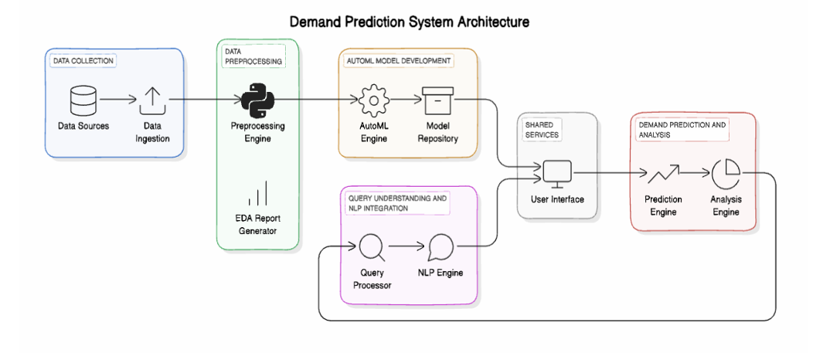
System Architecture

Slide 6
List of Modules
Data Collection and Cleaning
Exploratory Data Analysis
Feature Engineering
AutoML Model Selection and Ensembling
Model Evaluation
Web Application Integration
Reporting and Visualization

Slide 7
Functional Description for Data collection & Cleaning
Data Ingestion: User uploads data set through the UI
Data Validation: Verify data consistency by checking for duplicates, missing values, and inconsistencies.
Data Cleaning: Remove errors, handle null values, and standardize formats.
Preprocessing: Transform raw data into structured formats suitable for analysis, including normalization and feature extraction.

Slide 8
Functional Description for Exploratory Data Analysis
Descriptive Statistics: Summarize data using mean, median, variance, and distributions to understand trends and patterns.
Data Visualization: Use graphs and charts like histograms and scatterplots to explore relationships and outliers.
Correlation Analysis: Identify relationships between variables to select impactful features.
Data Insights: Detect anomalies, trends, and potential challenges for informed preprocessing and modeling decisions.

Slide 9
Functional Description for Feature Engineering
Feature Selection: Identify the most relevant features from the dataset using techniques like correlation and mutual information.
Feature Transformation: Normalize, scale, or encode data to ensure compatibility with machine learning algorithms.
Dimensionality Reduction: Simplify datasets using techniques like PCA to remove redundant or irrelevant features while retaining essential information.

Slide 10
Functional Description for AutoML model selection and Ensembling
Model Selection: Automatically evaluate multiple algorithms to identify the best-performing models based on accuracy, precision, or other metrics.
Hyperparameter Tuning: Optimize model parameters automatically to enhance performance and reduce overfitting.
Ensembling Techniques: Combine top models using methods like bagging, boosting, or stacking to improve robustness and accuracy.

Slide 11
Functional Description for Model Evaluation
Performance Metrics: Evaluate models using metrics like RMSE, MAE, accuracy, precision, recall, and F1-score to assess prediction quality.
Validation Techniques: Use cross-validation and train-test splits to ensure the model generalizes well to unseen data.
Comparative Analysis: Compare model performance to baseline methods and select the most reliable approach for deployment.

Slide 12
Functional Description for Web Application Integration
Frontend Integration: Uses an intuitive UI for users to upload datasets, configure options, and view demand predictions.
Backend Connectivity: Connect the web application to the prediction system and carry the models using Flask.
Scalability: Ensure the web application supports multiple users and large datasets while maintaining performance and reliability.

Slide 13
Functional Description for Reporting and Visualization
Trend Analysis: Visualize historical and forecasted demand patterns for better decision-making.
Export Options: Provide downloadable formats like PDF or Excel for sharing and offline analysis of results.
Interactive Dashboards: Create dynamic dashboards to display predictions, trends, and key insights using graphs, charts, and tables.

Slide 14
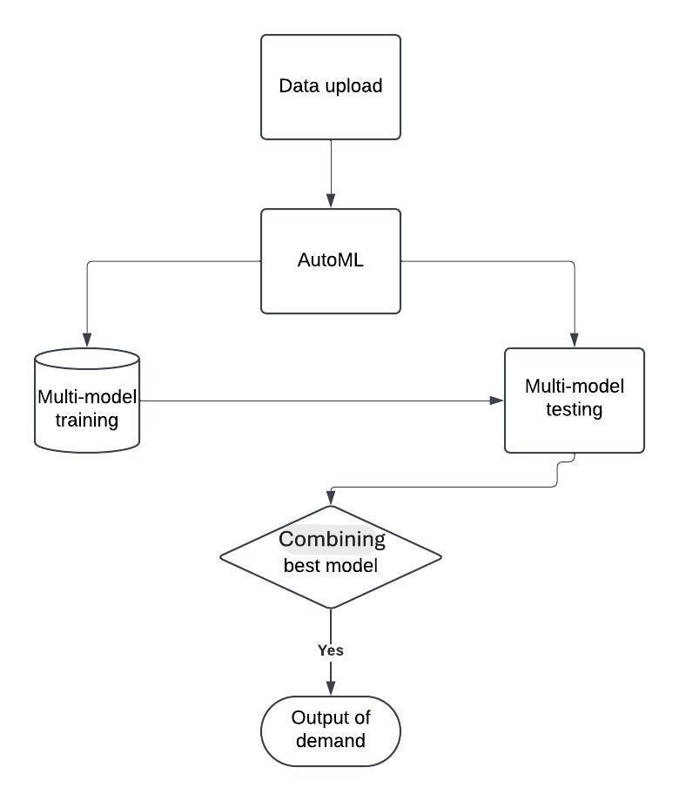
Data Flow Diagram

Slide 15
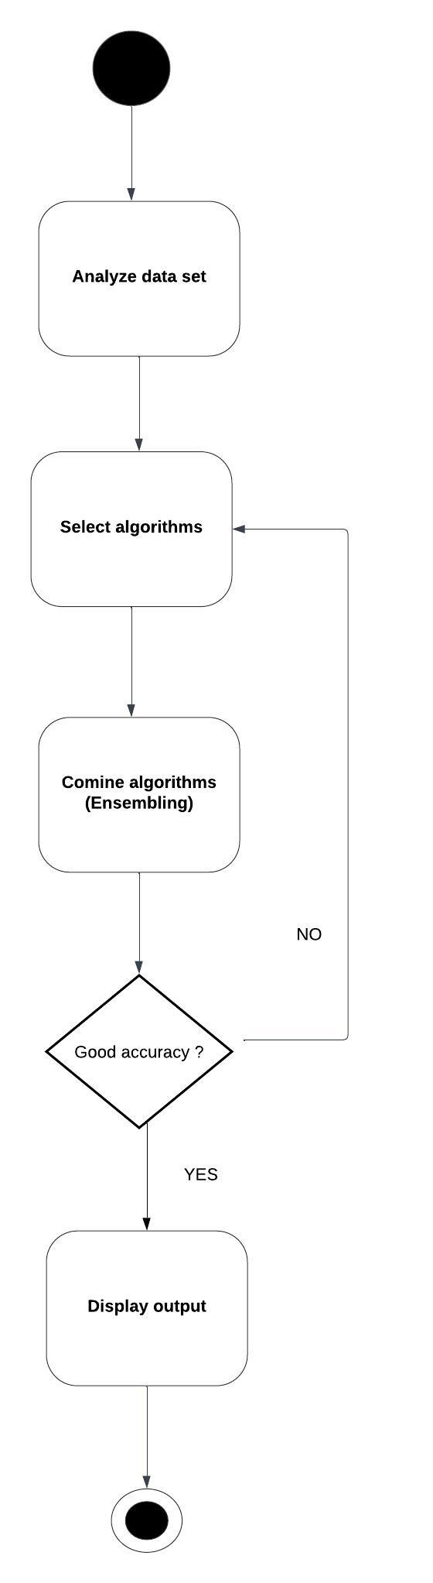
Functional Description for each modules with DFD and Activity Diagram

Slide 16
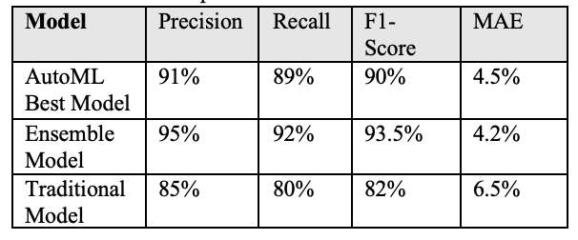
Implementation & Results of First Module
The AutoML-generated ensemble models are expected to deliver an accuracy of around 90-95% for short-term demand forecasts and 85-90% for longer-term predictions. In cases involving seasonal or highly volatile product categories, the system still maintains an accuracy of approximately 80-85%, outperforming many traditional models.

Slide 17
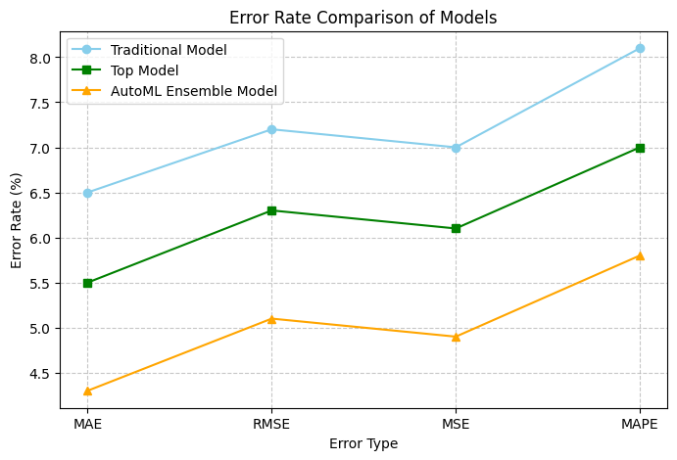
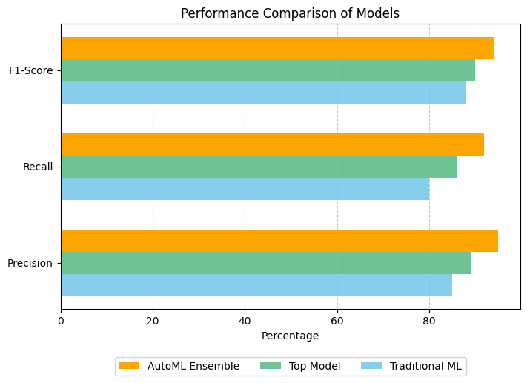
Implementation & Results of First Module

Slide 18
Pending Modules
Model Deployment & Integration:
Deploy the selected ensemble model into a user-friendly interface for real-world demand forecasting.
Real-Time Data Integration:
Incorporate live sales, market trends, and external factors to improve demand prediction accuracy.

Slide 19
Phase-I Paper Publication Details
TITLE : DEMAND PREDICTION USING AUTOML BASED ENSEMBLE ALGORITHM
AUTHORS: Senthil Pandi S, Kumar P, Nathaniel Abishek A, Mohamed Hussain S
CONFERENCE: International Conference on Artificial Intelligence and Data Engineering –AIDE 2025
MODE OF SUBMISSION: OFFLINE
STATUS: PRESENTED IN THE CONFERENCE

Slide 20
Thank You

